Slide 1
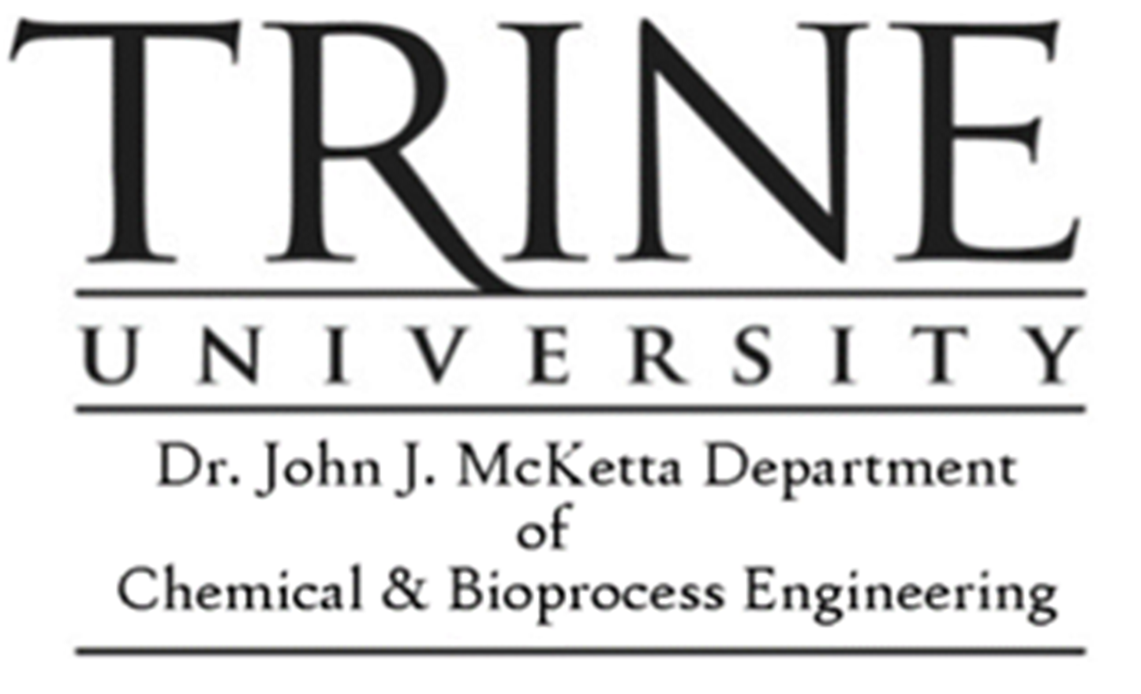
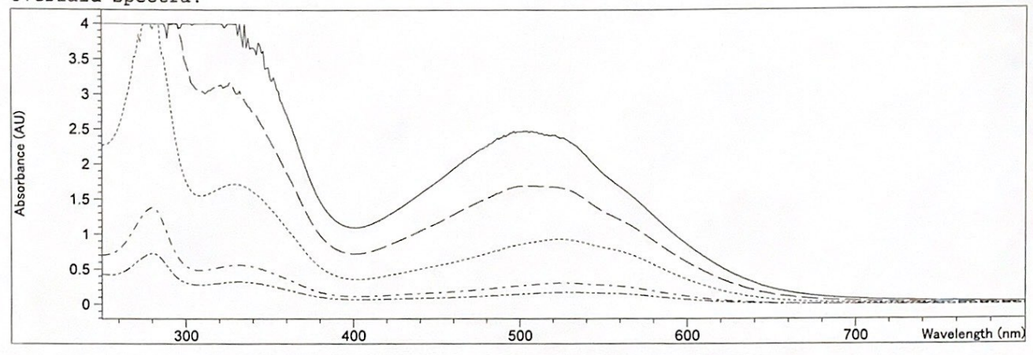
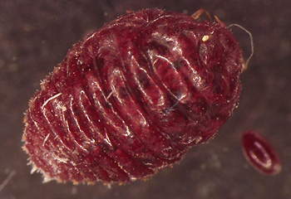
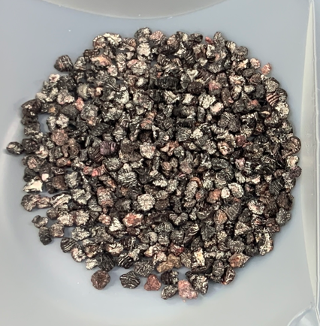
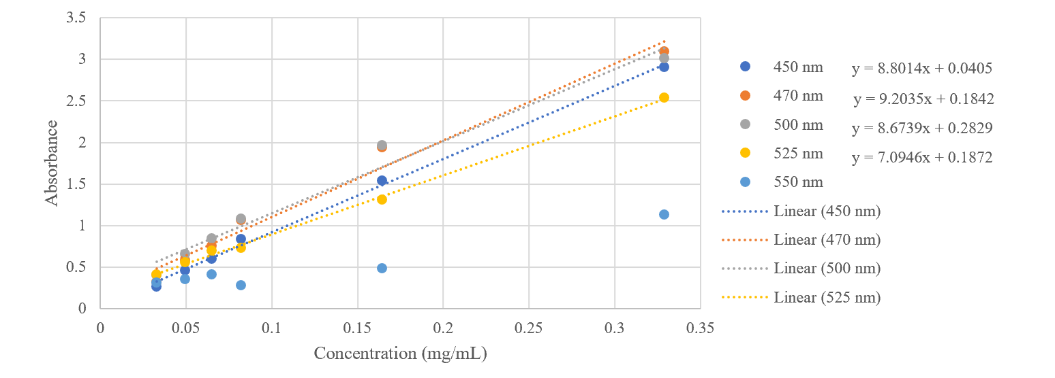
Variable and Purification Research on the Extraction of Carmine from Dactylopius Coccus
Danielle Gargiulo, Mentor: Jacob Borden
Dr. John J. McKetta Department of Chemical & Bioprocess Engineering, Trine University
ABSTRACT
Impact of Change of Variables:
Boil time
Alum amount/pH
Type of carbonate source: Na₂CO₃ or K₂CO₃
Carbonate concentration
Alum introduction time after boil
RESULTS & CONCLUSIONS (cont.)
Carmine/cochineal red pigments are extracted from the cochineal insect (Dactylopius coccus), a cactus-dwelling bug that is native to subtropical areas of Mexico and South America. The purity of carmine has been an issue in the cosmetic industry: it is one of the few pigments that are “eye safe” however, the pigment comes from extraction of cochineal bugs. Contaminates from the bugs can cause allergic reactions, so many companies are hesitant to use it for eye products. This research is done to find the causes of impurities and difference in yield, hue, and quality. Different parameters of the extraction process have been changed to find what causes these differences. Pure Carminic acid is used to find differences between the solutions and if/what impurities may be present.
Image 3. Pigment at pH of 7, 6, and 5, respectively.
Type of carbonate source: It was found that carbonate source had little effect on the final color or amount of pigment obtained; more trials are needed.
Carbonate concentration: It was found that carbonate type had little effect on the absorbance peak wavelength or value, however, more research trials are needed to make full conclusion.
Alum introduction time after boil: It was found that the time that the cochineal-alum solution after boil sat before being introduced to alum did effect the color of the pigment. With more time, more color was lost.
Figure 2. Absorption Spectra of Raw Cochineal Boil
Figure 4. Absorption Spectra of Pure Carminic Acid
Image 1. Female Dactylopius Coccus
Image 2. Dried Cochineal
OBJECTIVE
Research the methods of carmine extraction from Dactylopius Coccus and compare products to carminic acid solutions and pigments to find impurities.
Image 4. Pigment of Alum Introduction at times 30 minutes and 16 hours after Boil.
Figure 5. Calibration Curve of Pure Carminic Acid
Overall: Based on the calibration curve of the pure carminic acid, it was found that the concentration of carminic acid in the raw cochineal boil after 20 minutes is roughly 0.244 milligrams per milliliter on average.
RESULTS & CONCLUSIONS
EXTRACTION METHOD
Boil time: It was found that the less time the bag of cochineal is boiling in the water, the less time there is for it to react with the potash, so optimum boil time within the given range was 20 minutes,
REFERENCES
Alum/pH: The method was tested using a final pH of 7, 6, and 5, and it was found that the more alum, and lower the pH, the more pigment obtained, however, the lower the color tine.
Image 1:
Joyce, R. Crimson Love. Living Loved Today. https://www.livinglovedtoday.com/post/crimson-love (accessed 2024-04-04).
Method:
MAKING LAKE PIGMENT FROM COCHINEAL: A HISTORICAL RECONSTRUCTION. sandbox. https://cu-mkp.github.io/sandbox/docs/pigment-cochineal-lake_assignment.html (accessed 2024-04-04).
‌
Figure 1. Block Flow Diagram of Method
Notes:
BFD instead of method
Add table of concentration

