Slide 1

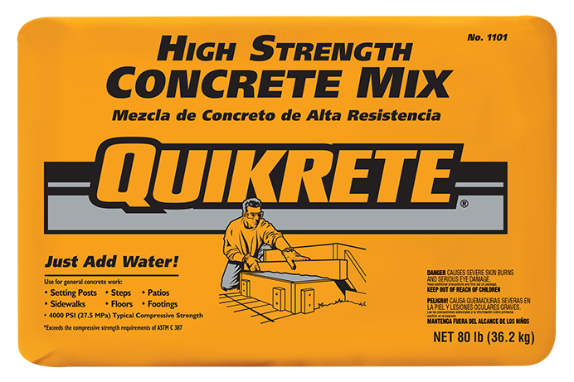
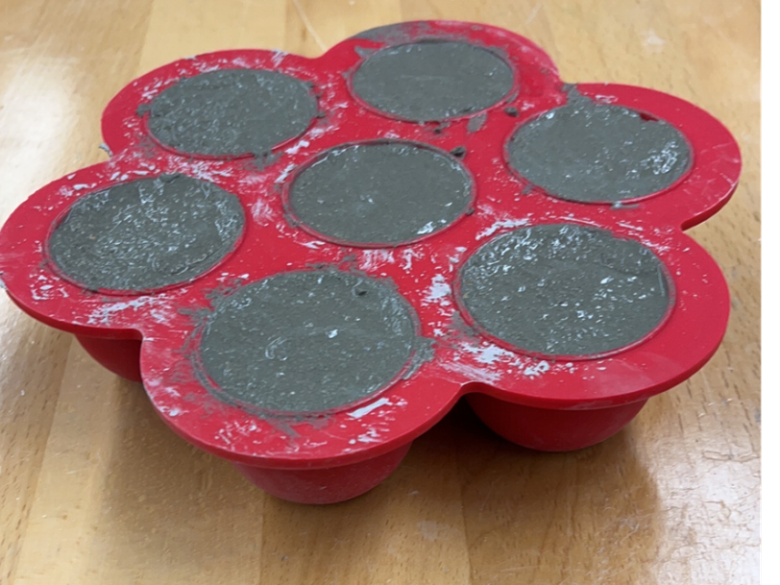
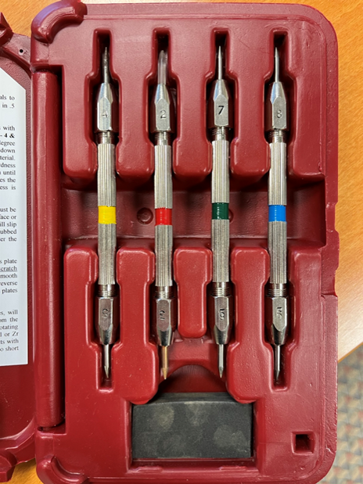
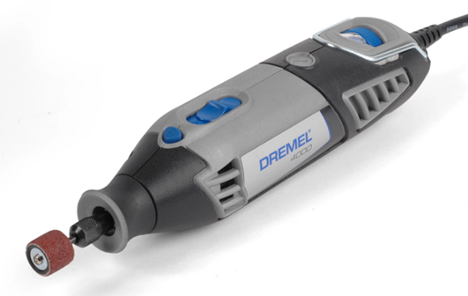
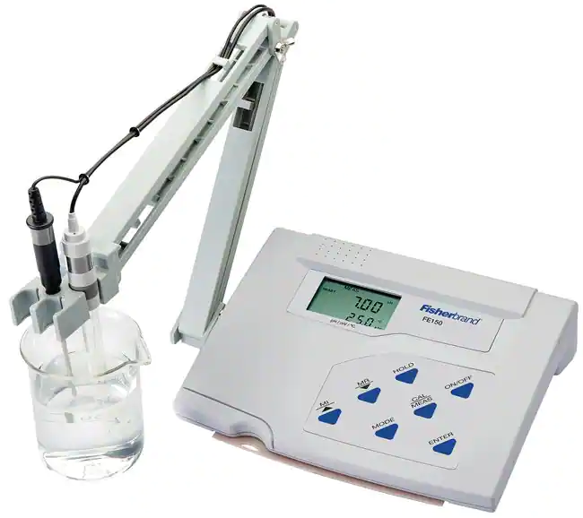
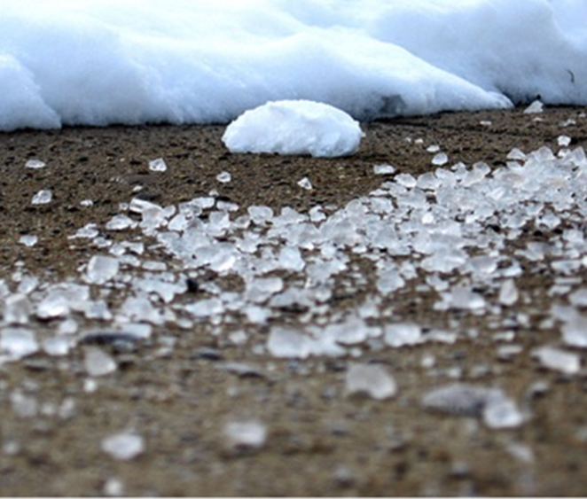
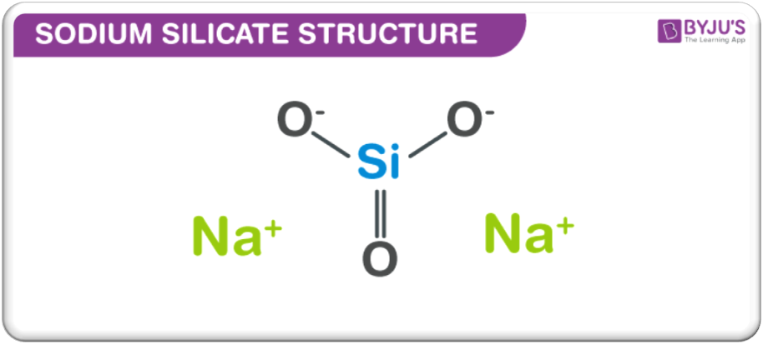
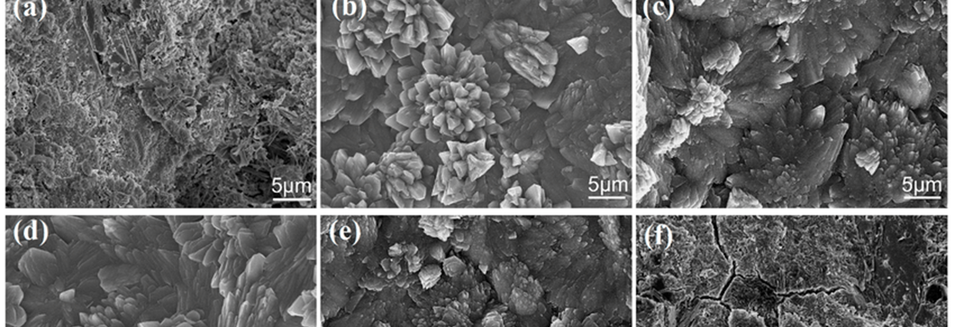
Mitigating the Effects of Road Salt on Concrete
Annamarie Lechleidner, Dr. Borden, J.
Materials
Methods
Mix concrete using 5.2 grams of mix per 1 mL of water
Use hardness testing pencils to determine the relative hardness on Mohs’ hardness scale
Grind a small portion of each sample to dust using Dremel tool
Mix 0.03 grams of sample with 6 mL distilled water and measure the pH
Data
Table 1. Hardness data collected on the first three concrete samples before salt baths
Table 2. pH data collected on the first three concrete samples before salt baths
Future Work
Abstract
Concrete is 10% cement, 30% sand, 40% gravel, and 20% air and water. Cement is made up primarily of lime (60-65%), silica (17-25%), and alumina (3-8%). Concrete can be damaged by the freeze/thaw cycle of water seeping into pores in the concrete which causes hydraulic pressure build-up and cracking.
Chloride salts such as calcium chloride, magnesium chloride, and sodium chloride are often used to minimize the freeze/thaw cycle by lowering the freezing point of the water. Unfortunately, these salts can lower the alkaline pH (usually around 11) of the concrete in addition to leaching the calcium hydroxide from the cement, weakening the structure of the concrete.
Objective
Utilize pH testing, hardness testing, SEM imaging to determine the effects of various road salts on concrete
Determine additives that could reduce damage to concrete, while maintaining effectiveness of the salt
Take SEM imaging of each sample of concrete
Place sample 2 in a water bath
Place samples 3-5 in baths of typically used road salts which consist of CaCl, MgCl, and NaCl
Place samples 6-9 in baths of commercial grade CaCl, MgCl, and NaCl
Reconduct pH testing, hardness testing, and SEM imaging on each sample
Quantify effects
Determine if reactive silicates can be added to the salts to mitigate damage but maintain effective freezing point depression
Figure 1. Structure of reactive sodium silicate being studied
Figure 2. Sample SEM images of different types of concrete
Quikrete masonry mix
Silicon molds
Hardness testing pencils
Dremel tool
pH probe
Graduated cylinders
Beakers
Distilled water
Road salts

