Slide 1
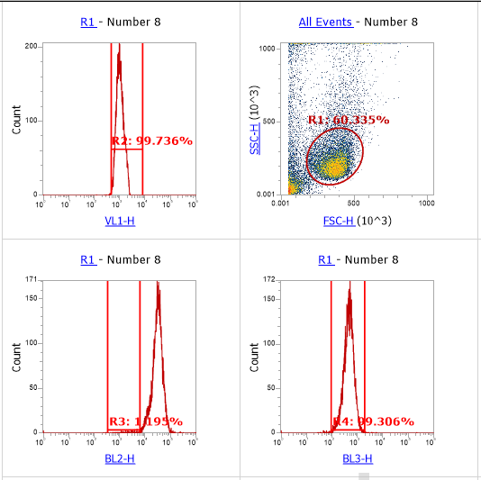
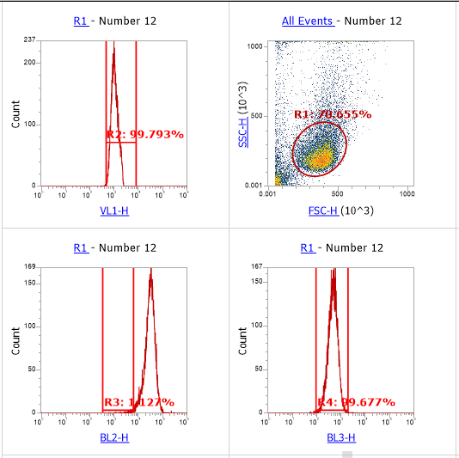
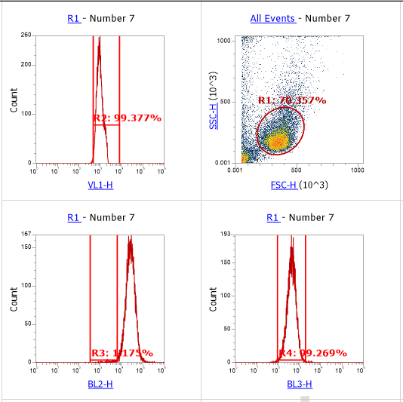
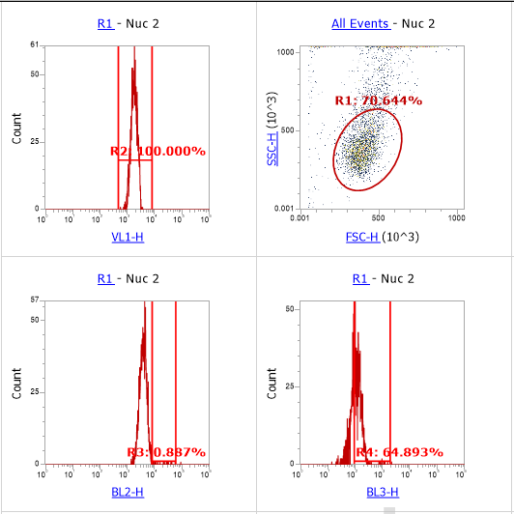
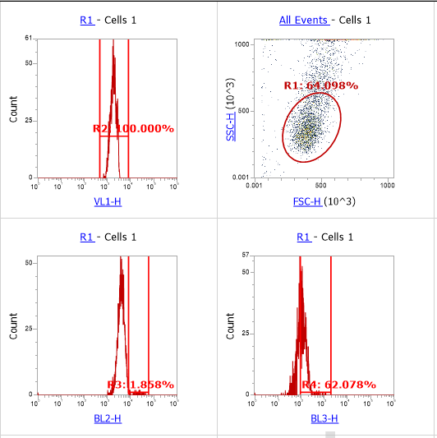
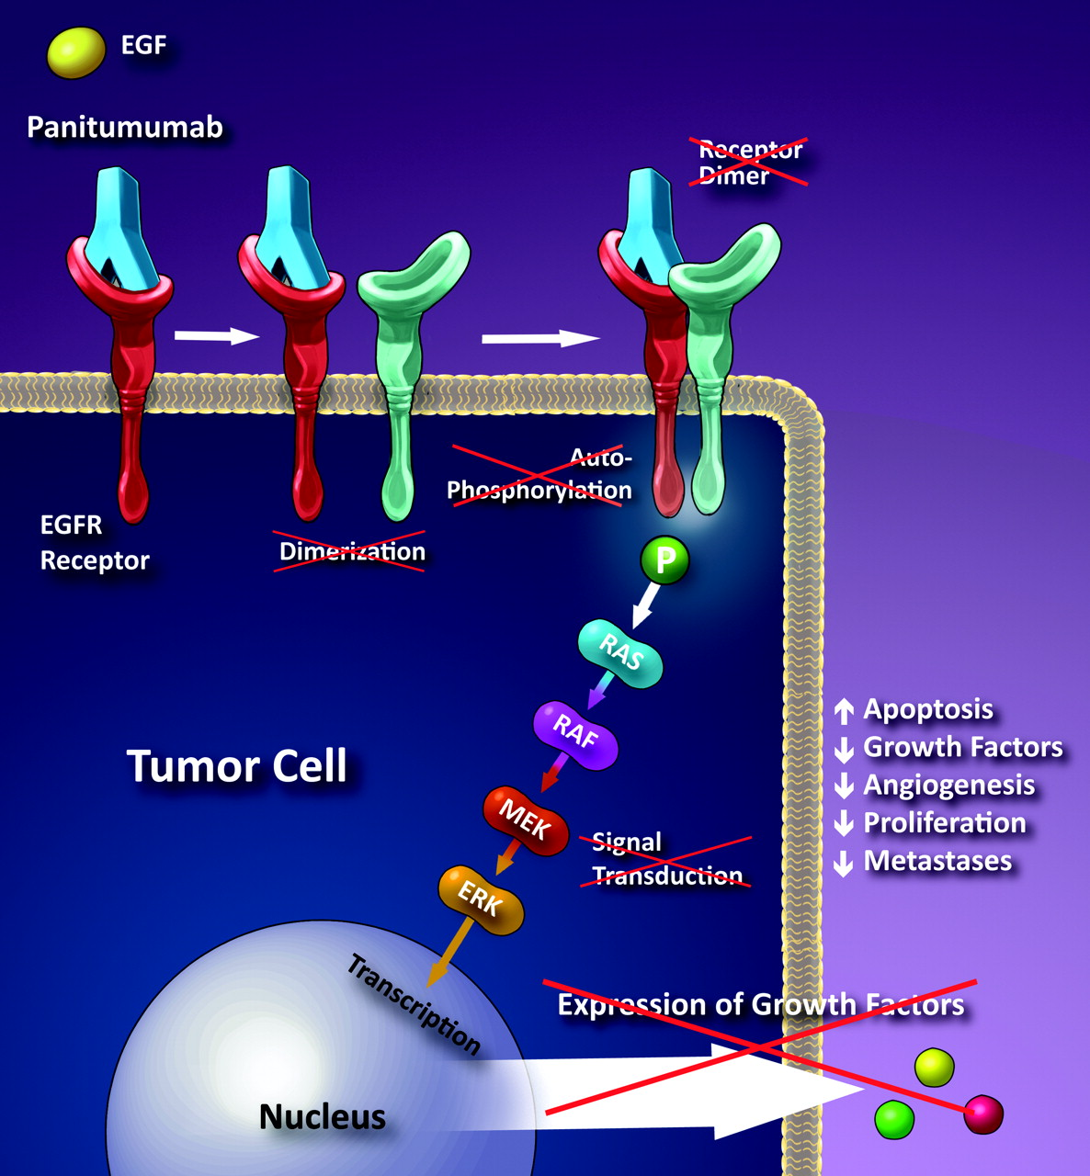
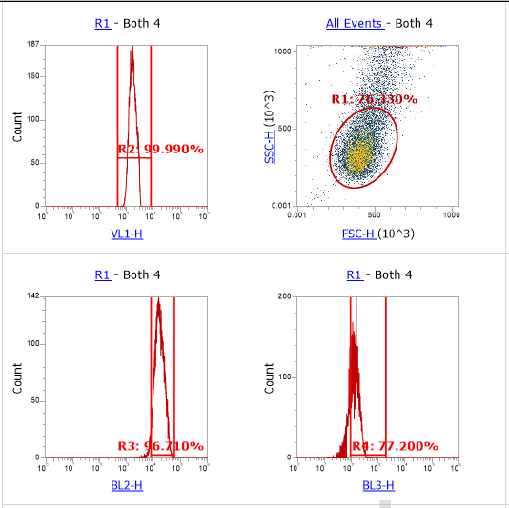
Optimizing Antibody Binding to HCT116 Epidermal Growth Factor Receptor
Marshall Beebe, Amanda P. Malefyt Ph.D.
McKetta Department of Chemical & Bioprocess Engineering, Trine University
Introduction
Flow Cytometer Results
Future Work
Colorectal cancer (CRC) is one of the leading causes of cancer-related mortality worldwide, with the epidermal growth factor receptor (EGFR) playing a crucial role in its progression. EGFR is a transmembrane receptor tyrosine kinase that, upon ligand binding, activates intracellular signaling pathways which regulate cell proliferation, survival, and migration. In CRC, overexpression of EGFR contributes to tumor growth. in than 60-80% of cases.¹ Panitumumab, a fully human monoclonal antibody targeting EGFR, functions by binding to the extracellular domain of EGFR, preventing its activation and blocking downstream signaling cascades.² This inhibition can reduce cell proliferation and enhance sensitivity to other therapeutic agents. This research focuses on optimizing antibody concentration for EGFR binding while also providing a quantitative and qualitative analysis through flow cytometry and fluorescent microscopy.
Figure 2: Flow cytometer results of HCT116 cells with antibody EGF Receptor XP® Rabbit mAb (Alexa Fluor® 488 Conjugate) targeting the EGF receptor.
Cells only
Alexa Fluor® 488 only
Alexa Fluor® 488 with NucBlue
Example of side scatter plot from the combination of the tags.
A
B
Implementing a procedure with the panitumumab antibody and Goat anti-Human IgG Fc Recombinant Secondary Antibody (Alexa Fluor™ 488) for tagging to visualize and quantify results.
Optimization of the concentration of the antibody used.
A
B
Alexa 488
C
Alexa 488
D
Methods
Alexa 555
Alexa 555
Figure 3: Flow cytometer results of HCT116 cells with EGFR Recombinant Rabbit Monoclonal Antibody Alexa Fluor® 555.
Cells Only
(B) Alexa Fluor® 555 at 5 mg/mL
HCT116 Cells were cultured in McCoy’s 5A media supplemented with FBS.
Recombinant Rabbit Monoclonal Antibody Alexa Fluor® 555 and EGF Receptor XP® Rabbit mAb (Alexa Fluor® 488 Conjugate) ³ were tested.
Initially, antibody with varying bovine serum albumin (BSA) concentrations in phosphate buffered saline (PBS) were used.
Next, HCT166 cells were fixed cells with 4% paraformaldehyde in PBS and then permeabilized in 90% methanol with PBS prior to antibody treatment.
Cells were also stained with NucBlue Live ReadyProbes Reagent for nuclear staining
Cells concentration was varied between 500,000 – 2,000,00 cells/mL
Fluorescence intensity was quantified using an Attune NxT Acoustic Focusing Cytometer and visualized using a Nikon Eclipse T/2 confocal fluorescent microscope.
Alexa 488
Figure 5: This image represents the mechanism by which the panitumumab antibody binds to the extracellular portion of EGFR. This binding would prevent dimerization and the cascade that leads towards cellular growth from EGFs. ⁴
Microscopy Results
A
B
Figure 4: Microscopy results of HCT116 cells with different magnifications. Cells were plated at 250,000 cells/mL and fixed with 4% paraformaldehyde in PBS. The antibody used is EGF Receptor XP® Rabbit mAb (Alexa Fluor® 488 Conjugate). A 1:100 dilution for the antibody to PBS was utilized.
(A): 20x with Alexa Fluor® 488 and NucBlue.
(B) 20x with NucBlue.
(C) 60x with Alexa Fluor® 488 and NucBlue.
(D) 60x with NucBlue.
Acknowledgements
HCT116 cells were used in a trial experiment with EGFR Recombinant Rabbit Monoclonal Antibody Alexa Fluor® 555. Well plates consisting of 12 total experiments were conducted with 6 varying bovine serum albumin (BSA) concentration from 0-5% in phosphate buffered saline (PBS) while keeping antibody concentration constant. The other 6 vary antibody concentration from 1-5 μL while keeping BSA concentration constant. Cells were plated at 2 mL with 500,000 cells/mL and incubated for 24 hours in media consisting of McCoy’s 5A, fetal bovine serum, and penicillin-streptomycin. After incubation, media was aspirated, and the wells received the solution of BSA in their respective wells. Each well was given their associated antibody/BSA system and incubated for 1 hour in darkness. They were also stained with NucBlue Live ReadyProbes Reagent for nuclear staining and incubated for 15 minutes in darkness. Another experiment was conducted using Alexa Fluor® 488 Conjugate.³ In this experiment, cells were plated at 2,000,000 cells/mL and were fixed with 4% paraformaldehyde in PBS and then permeabilized in 90% methanol with PBS. A total of 4 controls consisting of cells only, cells with NucBlue, cells with antibody, and cells with both NucBlue and antibody were plated. Cell absorbances were quantified using an Attune NxT Acoustic Focusing Cytometer and visualized using a confocal fluorescent microscope.
I would like to thank INSGC for the grant, without it this research would not have been made possible. I would also like to personally thank Dr. Malefyt, for her time, expertise, help in quantifying the results. Her continued support through this research allowed for a research experience like no other. Additionally, I would like to thank BioNanomics for help and use of their confocal microscope to produce the images.
C
D
References
← Update this section with any references you are using for the previous sections. Remove the ones you aren’t currently using
García-Foncillas, J., Sunakawa, Y., Aderka, D. et al. (2019, August 19). Distinguishing features of Cetuximab and panitumumab in colorectal cancer and other solid tumors. Frontiers. https://www.frontiersin.org/journals/oncology/articles/10.3389/fonc.2019.00849/full#:~:text=Cetuximab%20and%20panitumumab%20both%20function,and%20either%20degraded%20or%20recycled.
Vitiello, P.P., Cardone, C., Martini, G. et al. Receptor tyrosine kinase-dependent PI3K activation is an escape mechanism to vertical suppression of the EGFR/RAS/MAPK pathway in KRAS-mutated human colorectal cancer cell lines. J Exp Clin Cancer Res 38, 41 (2019). https://doi.org/10.1186/s13046-019-1035-0.
Cell Signaling Technology. EGF receptor (D38B1) XP® Rabbit mAb (Alexa Fluor® 488 conjugate) #5616. https://www.cellsignal.com/products/antibody-conjugates/egf-receptor-d38b1-xp-rabbit-mab-alexa-fluor-488-conjugate/5616. Retrieved 10 Mar, 2025.
Gemmete, J. J., & Mukherji, S. K. (2011). Figure 1. In Panitumumab (Vectibix). American Journal of Neuroradiology, 32(6), 1002–1003. https://www.ajnr.org/content/32/6/1002/F1.
Figure 1: HCT116 cells with brightfield taken at 20x.

