Slide 1
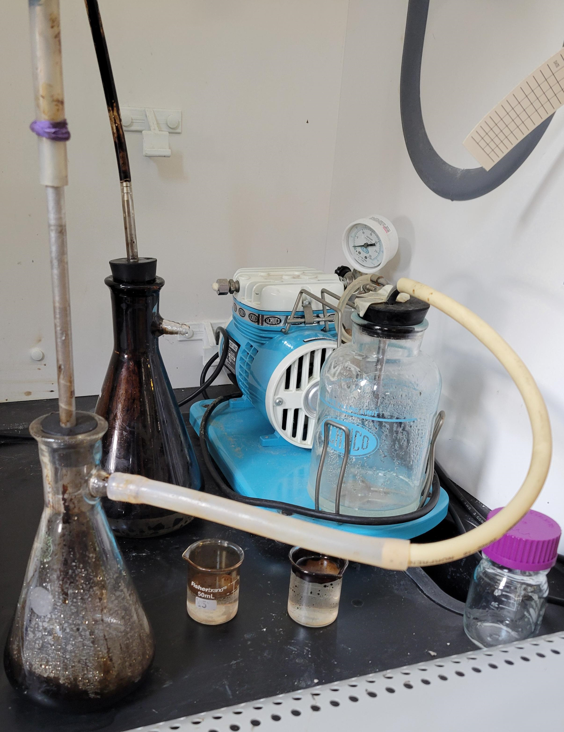
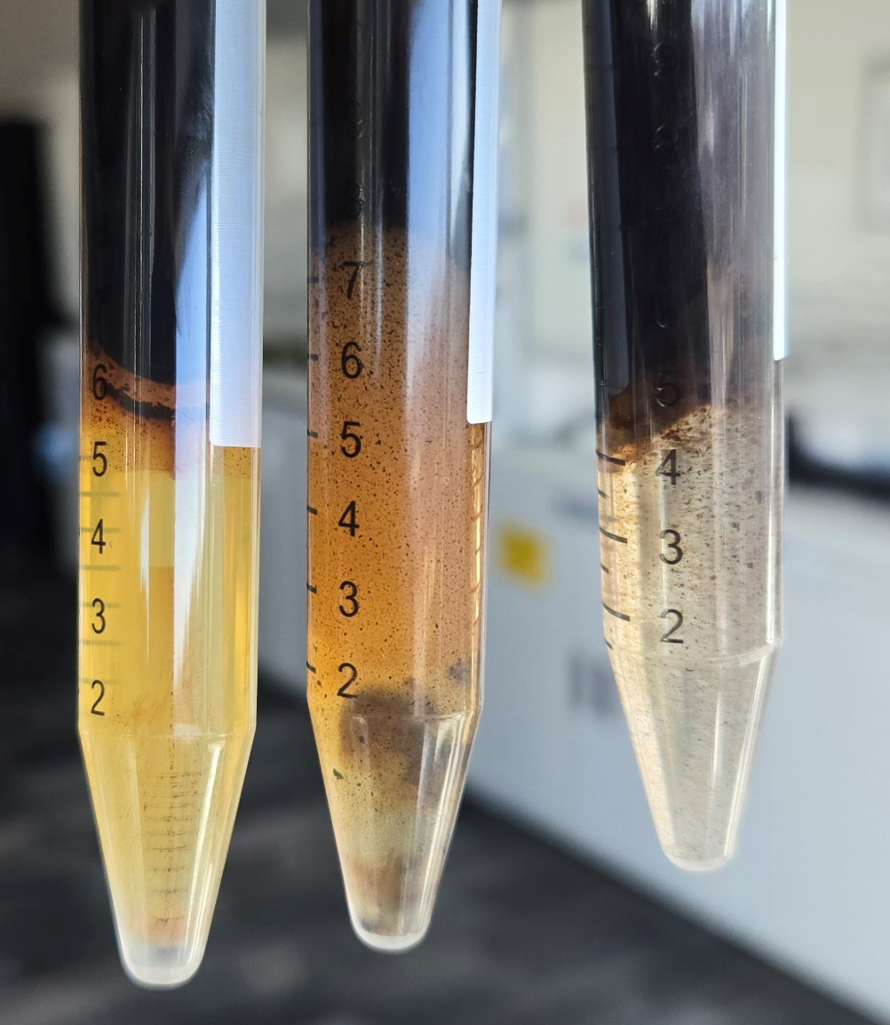
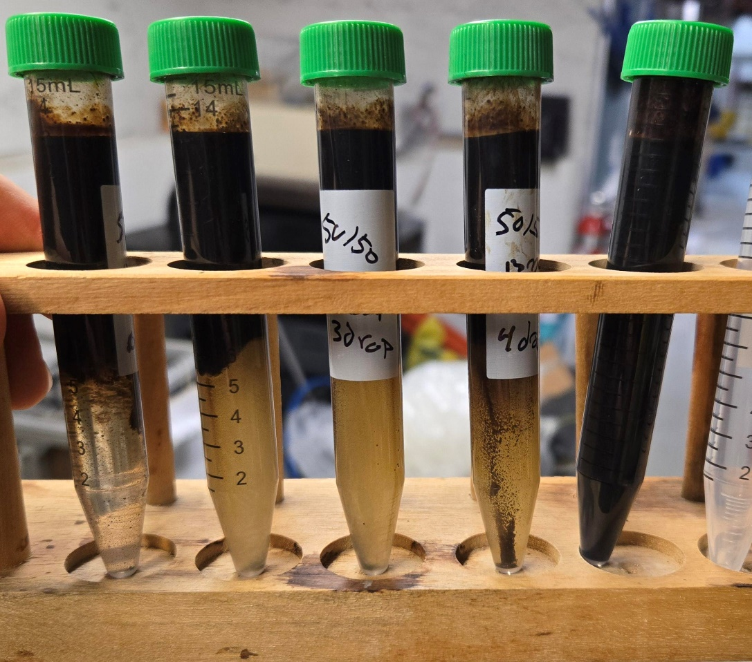
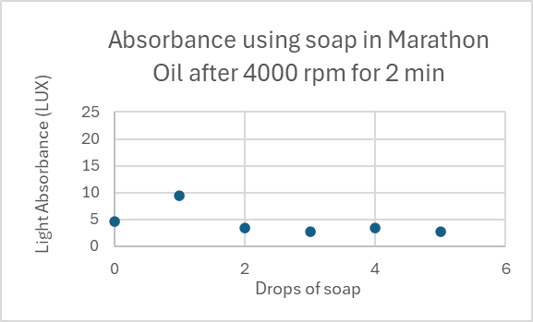
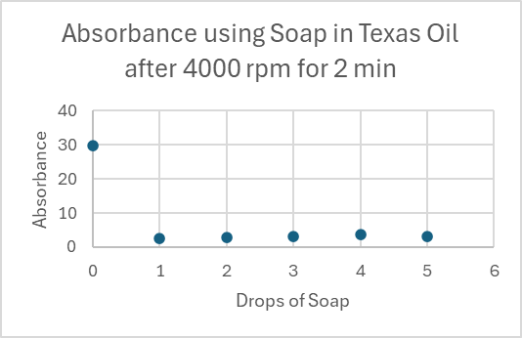
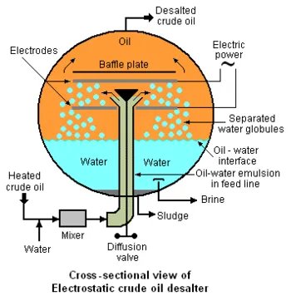
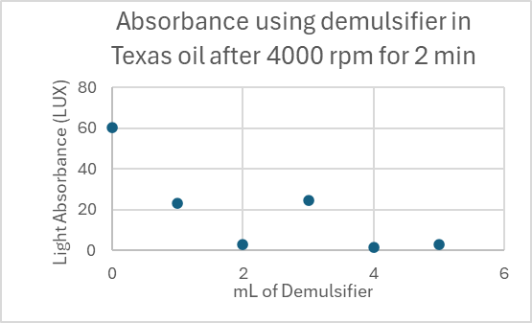
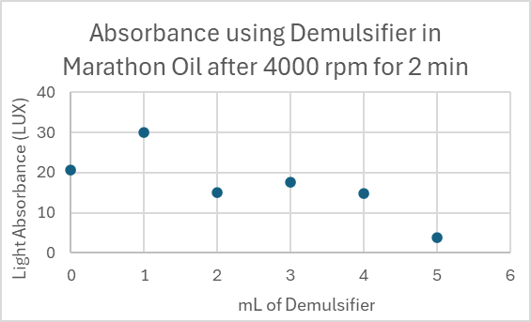
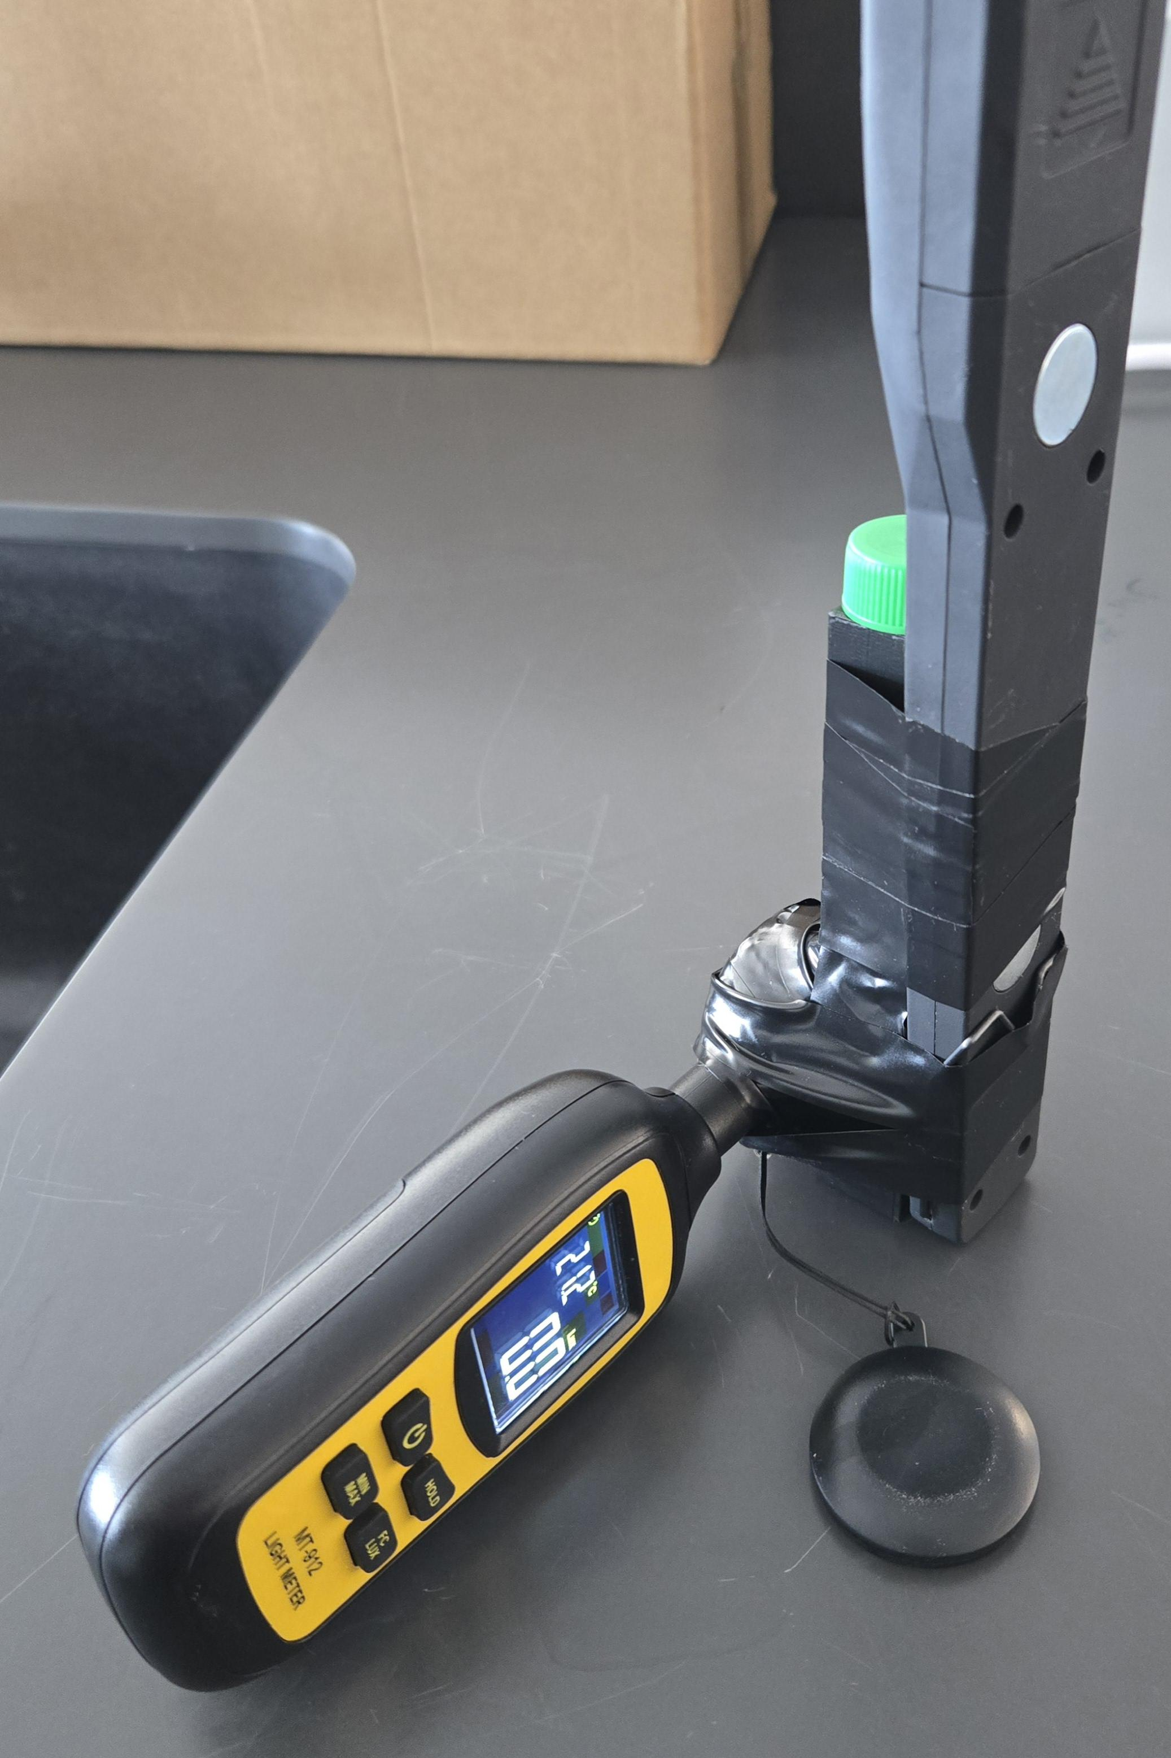
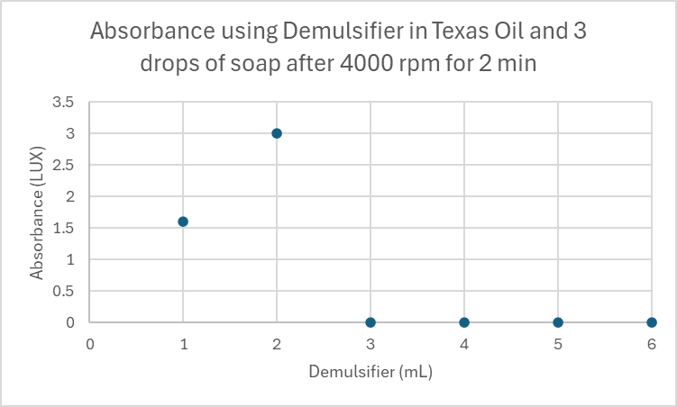
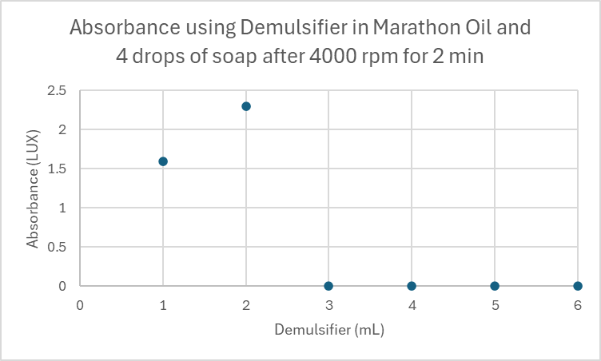
Separation of Crude Oil and Water
Joshua L. Scott
Dr. John J. McKetta Department of Chemical & Bioprocess Engineering, Trine University
ABSTRACT
MATERIALS & METHODS
DATA & RESULTS
In response to the escalating demand for oil and the depletion of light crude reserves, this study examines oil and water separation in heavy crude oil processing using emulsifiers and demulsifiers. Focusing on efficient separation, absorbance measurements are used to evaluate the effectiveness of various demulsifiers and emulsifiers. Ultimately, the findings aim to optimize separation processes to improve refining efficiency and reduce environmental contaminants.
First Setup
INTRODUCTION
A significant concern when processing crude oil is the presence of salts, which must be separated before the refining process can commence. Failure to do so can result in detrimental effects during distillation, as the high temperatures exacerbate the corrosive nature of the salts, leading to damage to the equipment. Typically, the separation process involves washing out the salts with water, resulting in a mixture of salt, crude oil, and water using an emulsifier. This is done in a unit called a desalter.
Role of demulsifiers:
Critical in separation process
Leverage silicon-based compounds
Attract water, repel oil
Importance:
Facilitates separation of water and salt from crude oil
Ensures smoother refining process
Safeguards equipment integrity
Figure 4: Samples of different tests after centrifuge
Figure 5: Samples of different tests after centrifuge
Figure 2: Setup for testing salt and oil concentration
The first experimental setup was designed to draw the water layer to identify the amount of oil and salt in the sample. The setup led to the finding that dawn dish soap was a good emulsifier for marathon crude oil and water. The setup was inefficient due to using to much material and taking a long time for experimental setup and testing.
Graph 1: Dawn dish soap used as emulsifier
Graph 2: Dawn dish soap used as emulsifier
Current Setup
Graph 3: Dowsil DM5 used as demulsifier
Graph 4: Dowsil DM5 used as demulsifier
Figure 1: Industrial desalter process
Graph 5: Effectiveness of DM5 on Dawn and Texas Crude
Graph 6: Effectiveness of DM5 on Dawn and Marathon Crude
CONCLUSIONS
Dawn dish soap contains powerful surfactants like sodium lauryl sulfate that create a stable oil-in-water emulsion by surrounding oil droplets with a charged, protective layer. Silicone-based demulsifiers usually work best in water-in-oil systems and struggle here because they can’t penetrate or disrupt Dawn’s strong surfactant film. They also tend to stay in the oil phase, while the emulsion is stabilized in the water phase.
RESEARCH OBJECTIVES
Future Works
Acknowledgments
Determine if emulsifiers and demulsifiers work uniformly across different crude oils.
Establish effective ratios for demulsifiers and emulsifiers
Figure 3: Current experimental setup to measure absorbance
Explore different emulsifiers and demulsifiers
Study the effect heat has on the separation
Employ Electroporation and study the separation affects
Marathon Petroleum
Texas Raw Crude
Dow Chemical
McKetta Department of Chemical and Bioprocess Engineering
Dr. Jacob R. Borden

