Slide 1
Media Optimization for Biofuels from Cyclotella cryptica
Alyssa Keptner, Dr. Jacob Borden McKetta Department of Chemical and Bioprocess Engineering

Slide 2
Research Goals
Overall goal is to use the lipids in diatoms to make biofuels
Maximize growth of diatoms for lipid productivity

Slide 3
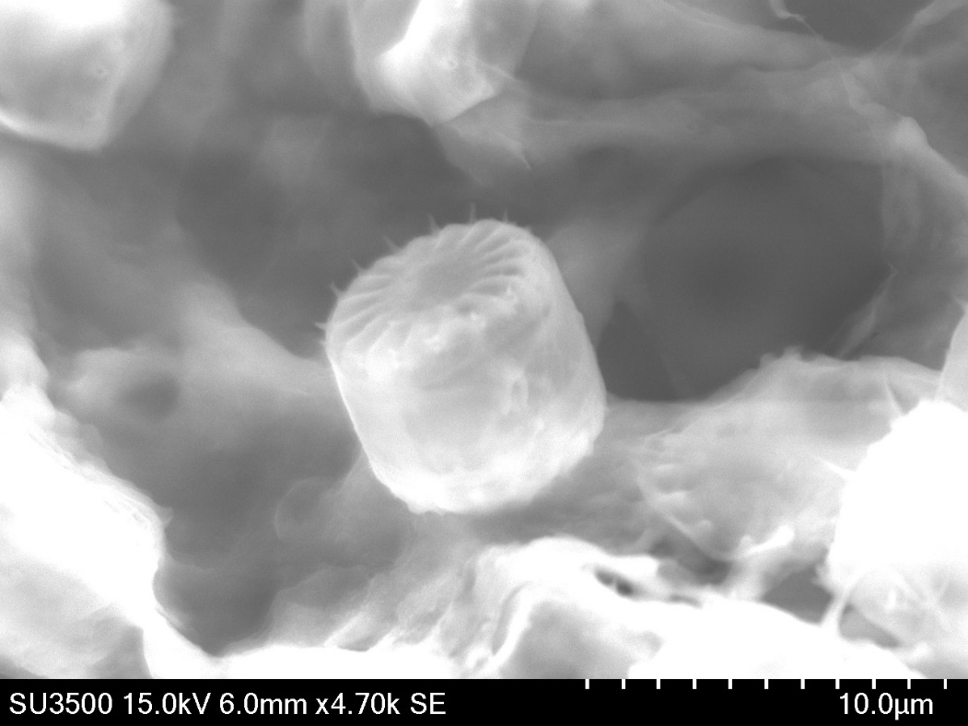
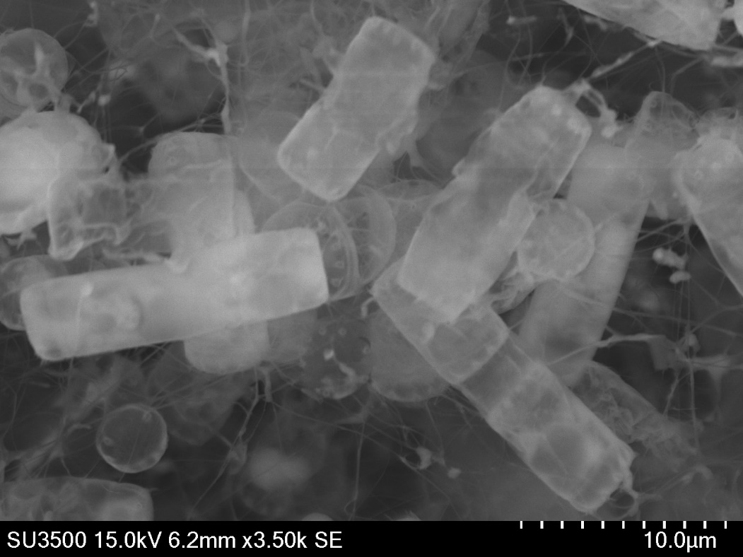
Introduction
Working with diatom species Cyclotella cryptica (C. cryptica)
Notes:
Diatoms are main component of phytoplankton
Diatoms have a silica shell making them unique compared to green algae
Working with diatom species Cyclotella cryptica
C. cryptica are about 40% lipids, and about 55% of that was triacylglycerol (TAG)

Slide 4
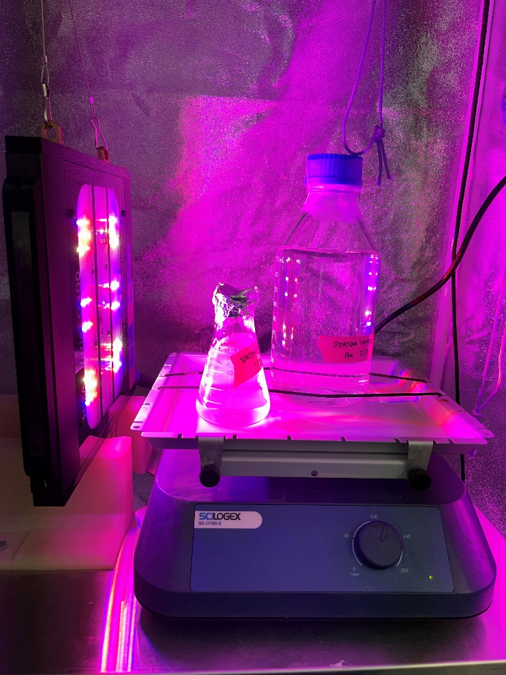
Experimental Set-Up
Grow tent at 21 °C
Grow light- 18 hours on, 6 hours off
Shaker plate for aeration & mixing

Slide 5
Overall Growth Determined Using Optical Density
Measured using absorbance on a plate reader at 436 nm
No mathematical correlation from OD to cell density
Triplicates of data were taken, average was used to find normalized OD

Slide 6
Media Base Components
Lab created seawater- 28 g/L NaCl
Growth additives
NaNO₃
NaH₂PO₄·H₂O
Na₂SiO₃ · 9H₂O
Trace Element Solution
Vitamin Solution

Slide 7
Real Seawater vs Lab Created Seawater
Real seawater pulled from Boston Harbor in the fall of 2021
Notes:
21 David G Mugar Way, Boston, MA 02114

Slide 8
Boston Seawater vs Lab Created Seawater
Boston seawater base resulted in better growth than lab created seawater base by a factor of 7.6
Notes:
Real seawater trials were completed with water from Boston harbor (pulled in Fall of 2021 for AIChE Nationals)
Difference was that 1 was all fake seawater, 1 was all real seawater
250 mL total volume
8 days of growth
450% change of real seawater or a 60% change of lab created

Slide 9
Boston Seawater vs Lab Created Seawater
Normalized OD and actual OD show similar results- use normalized OD

Slide 10
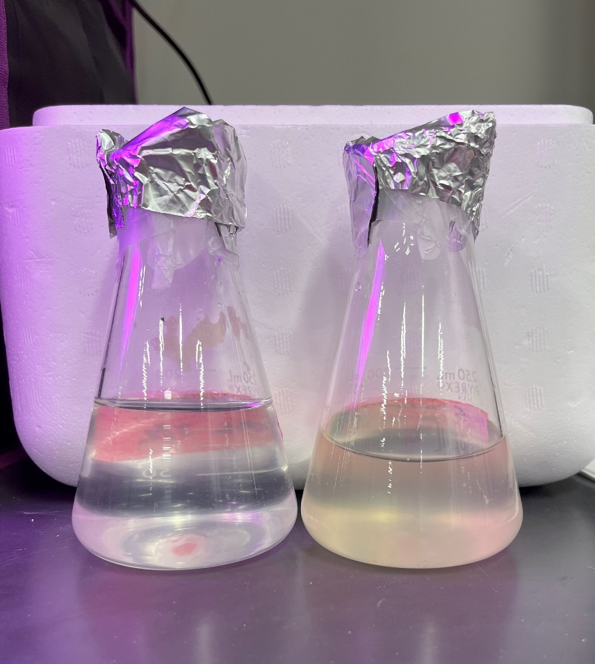
Real Seawater Grows C. cryptica Better
Some nutrient(s) present in real seawater that are absent or in lesser concentration in lab created seawater
Next step- Test growth additives to see if any additives majorly affect growth
Lab Created
Boston

Slide 11
Design of Experiments (DOE)
Determining what growth additives have a statistical impact on C. cryptica growth
Five growth additives
NaNO₃ (1x is 0.882 mM)
NaH₂PO₄·H₂O (1x is 0.0362 mM)
Na₂SiO₃ · 9H₂O (1x is 0.106 mM)
Trace Element Solution (1x is 1 mL/1000L)
Vitamin Solution (1x is 0.5 mL/1000L)
Varied concentration
High (2x)
Medium (1x)
Low (0.5x)

Slide 12
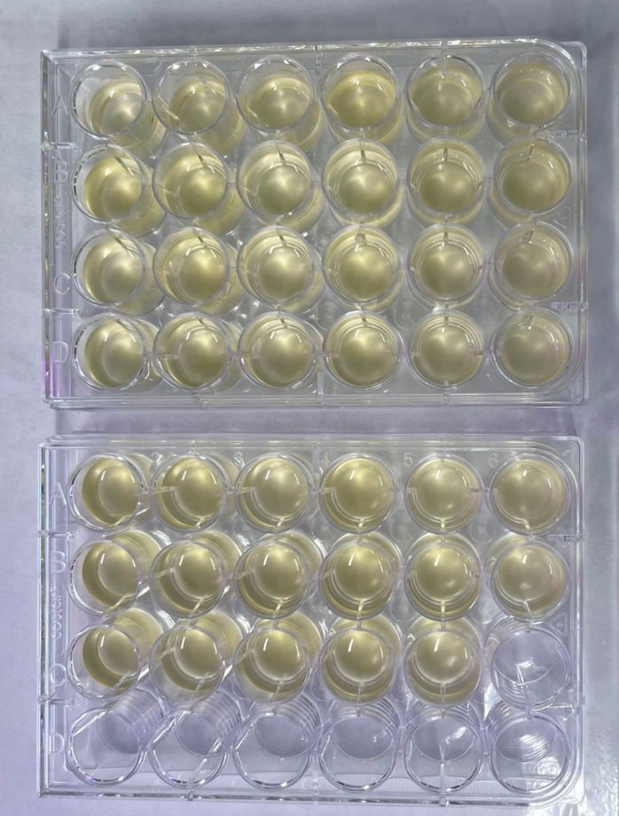
DOE
Grow Light
Well Plate
Shaker Plate
65 total trials- 2mL total volume

Slide 13
DOE Results
Silica was the only growth additive with a statistical impact on C. cryptica growth

Slide 14
Varying Silica Concentration
1x is 0.106 mM
Trial 1: 0.5x, 1x, 5x
Trial 2: 1x, 2x, 3x, 4x
Silica concentration
Heteropoly blue method (Hach reagent set)
Absorbance on plate reader
Lipid concentration
Nile red staining
Fluorescence on flow cytometer
Grow Light
Notes:
Heteropoly Blue method tested using a microplate reader read at OD 815 nm
Flow cytometer excitation was 488 nm, emission was 695 nm for Nile red
No agitation, could impact results slightly but not by much

Slide 15
Trial 1- Normalized Optical Density
Varying Silica Concentration
1x concentration was the best, 5x concentration showed no growth

Slide 16
Trial 2- Normalized Optical Density
Varying Silica Concentration
2x concentration was the best, at too high of a silica concentration growth begins to decrease

Slide 17
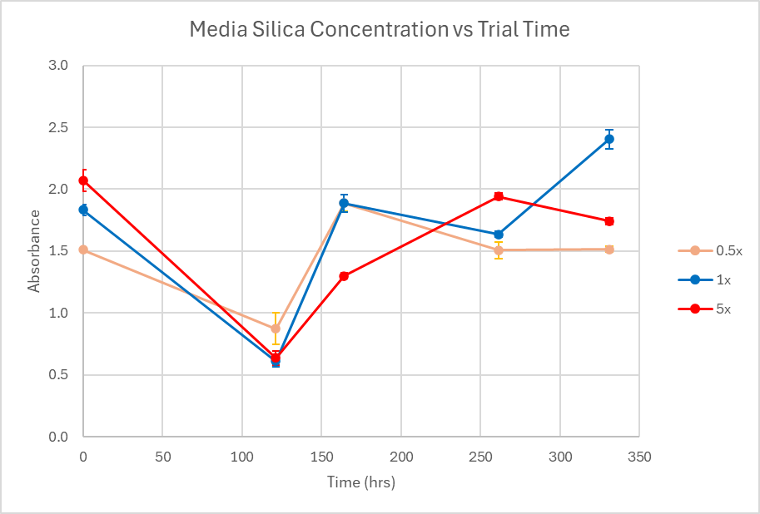
Trial 1- Testing Media Silica Concentration
Varying Silica Concentration

Slide 18
Trial 2- Testing Media Silica Concentration
Varying Silica Concentration

Slide 19
Testing Media Silica Concentration Conclusions
Inconsistent results between trial 1 and trial 2
Need a better method to measure silica concentration in media throughout the trial
Redo growth trials

Slide 20
Trial 1- Lipid Density at 331 Hours
Varying Silica Concentration
Intensity
Intensity
Intensity
5x concentration had no lipid growth
Notes:
X-axis is intensity
Y-axis is the cell count (difference between the count is the difference between trials, constant volume was pulled)
Chart is showing how many cells have that intensity, big peak is showing there are a bunch of cells with not much excitation, but the smaller peak shows a few cells that do have that fat or lipid

Slide 21
Trial 2- Lipid Density at 336 Hours
Varying Silica Concentration
Intensity
Intensity
Intensity
Intensity
2x concentration had best lipid growth
Notes:
X-axis is intensity
Y-axis is the cell count (difference between the count is the difference between trials, constant volume was pulled)
Chart is showing how many cells have that intensity, big peak is showing there are a bunch of cells with not much excitation, but the smaller peak shows a few cells that do have that fat or lipid

Slide 22
Conclusions- Lipid Density
2x concentration of silica had the highest peak of lipid density compared to overall cell density
Intensity

Slide 23
Future Studies
Water quality testing to determine what is in the Boston seawater
Real seawater media base showed 2x more silica than lab created seawater media base
Two stage growth for maximizing lipid growth
Nutrient replete & nutrient deplete
Lipid extraction (transesterification, bead milling)
d’Ippolito, G., Sardo, A., Paris, D. et al. Potential of lipid metabolism in marine diatoms for biofuel production. Biotechnol Biofuels 8, 28 (2015). https://doi.org/10.1186/s13068-015-0212-4

Slide 24
Conclusions
Out of the five growth additives put in media base, silica was the only additive with a statistical impact on overall C. cryptica growth
Silica concentration of 0.212 mM lead to the best overall growth and lipid growth in C. cryptica
Real seawater contains many nutrients not present in lab created- lead to better overall growth

Slide 25
Acknowledgements
Dr. Samuel Drerup for starting sample of C. cryptica
Rinker Ross School of Health Sciences, Trine University
Funding by the McKetta Department of Chemical and Bioprocess Engineering, Trine University
Dr. Jacob Borden

Slide 26
References
Guillard, R. R. L., & Hargraves, P. E. (1993). Stichochrysis immobilis is a diatom, not a chrysophyte. Phycologia, 32(3), 234–236. https://doi.org/10.2216/i0031-8884-32-3-234.1
Hildebrand, M., Davis, A. K., Smith, S. R., Traller, J. C., & Abbriano, R. (2012). The place of diatoms in the biofuels industry. Biofuels, 3(2), 221–240. https://doi.org/10.4155/bfs.11.157
d’Ippolito, G., Sardo, A., Paris, D. et al. Potential of lipid metabolism in marine diatoms for biofuel production. Biotechnol Biofuels 8, 28 (2015). https://doi.org/10.1186/s13068-015-0212-4
Gao G, Wu M, Fu Q, Li X, Xu J. A two-stage model with nitrogen and silicon limitation enhances lipid productivity and biodiesel features of the marine bloom-forming diatom Skeletonema costatum. Bioresour Technol. 2019 Oct;289:121717. doi: 10.1016/j.biortech.2019.121717. Epub 2019 Jun 27. PMID: 31279322.

Slide 27
Questions?
Out of the five growth additives put in media base, silica was the only additive with a statistical impact on overall C. cryptica growth
Silica concentration of 0.212 mM lead to the best overall growth and lipid growth in C. cryptica
Real seawater contains many nutrients not present in lab created- lead to better overall growth

Slide 28
Appendix

Slide 29
Growth Additives
L1 marine media component list and concentrations (based on 1 L total volume)

Slide 30
Microplate Reader- SpectraMax iD3
Overall Optical Density: Absorbance- 436 nm
Nile Red Method: Fluorescence- Excitation 488 nm, Emission 695 nm
Heteropoly Blue Method: Absorbance- 815 nm

Slide 31
Heteropoly Blue Method
Hach Reagent Set
10 mL total volume
Testing for 0.01-1.6 mg/L SiO₂
Molybdate 3 Solution
Citric Acid Reagent
Destruction of phosphate interference
Amino Acid F Reagent
Blue color indicates silica is present

Slide 32
Trial 1- Optical Density
Varying Silica Concentration
1x concentration was the best, 5x concentration showed no growth

Slide 33
Trial 2- Optical Density
Varying Silica Concentration
2x concentration was the best, too high of a silica concentration begins to decrease growth

