Slide 1
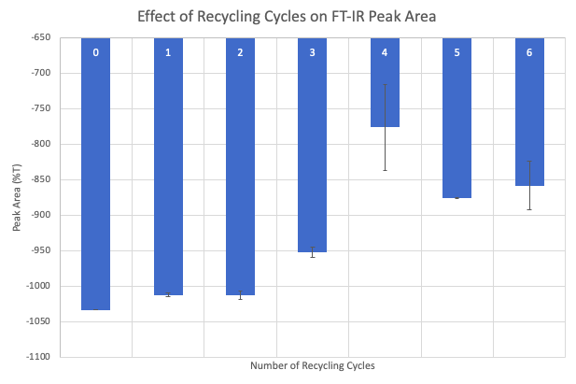
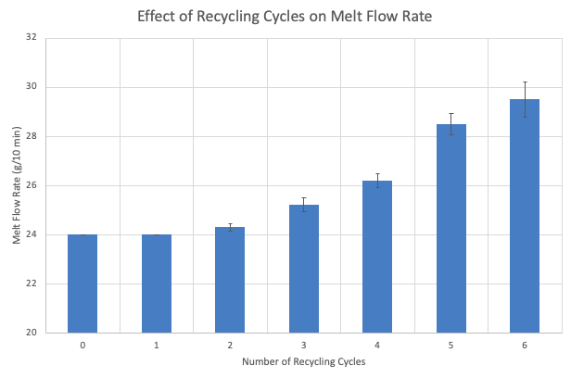
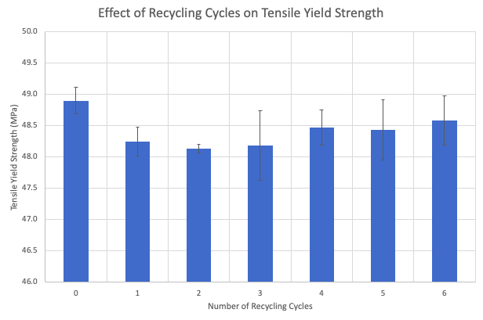
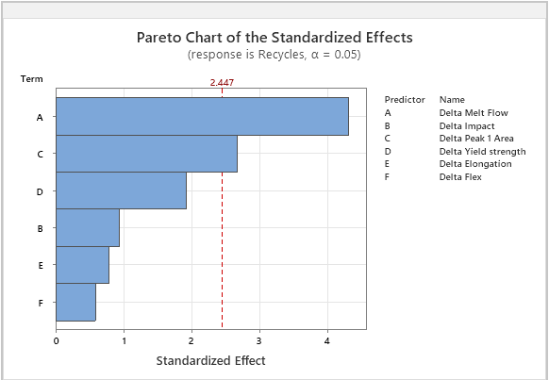
Quantifying Thermal Degradation in Recycled PC-ABS
Taylor Early, Amanda P. Malefyt
Trine University McKetta Department of Chemical & Bioprocess Engineering
Introduction
Sample Preparation and Testing
Conclusion
PC-ABS demonstrated degradation with repeated recycling, shown by increased melt flow rate and reduced mechanical properties. FTIR analysis revealed chemical changes likely due to oxidation. By fitting the experimental data, a predictive regression model was developed to estimate the number of recycling cycles based on the Δ (delta) between virgin and recycled material properties.
Future Work:
Conduct additional recycling rounds
Test multiple virgin PC-ABS specifications
Incorporate grinding and re-molding between each cycle to better simulate industrial recycling
Refine the predictive model for broader applicability and improved accuracy across varying PC-ABS formulations
PC-ABS is a co-polymer combining the strength of polycarbonate and flexibility of ABS
Recycled PC-ABS is a cost-effective, sustainable alternative to virgin resin
PC-ABS was selected for due to its wide industrial use and sensitivity to thermal degradation
Repeated heating due to recycling degrades the material’s properties
Understanding this degradation is key to improving the quality and consistency of recycled materials
Some recycled plastics now enter their second or third life cycle, amplifying these effects
Demand for high-performance recycled plastics continues to grow due to sustainability goals and cost savings
Objective: To characterize the thermal degradation of PC-ABS under repeated heat exposure from the recycling process by monitoring changes in mechanical and processing properties.
Started with grinded, virgin PC-ABS parts as baseline material
Subjected material to a series of controlled recycling cycles
Collected and prepared samples for testing after each cycle
Performed melt flow rate, impact strength, tensile strength, flexural modulus, and FTIR spectroscopy on all samples
Results
Figure 1. FTIR carbonyl group peak area decreases with increasing recycling cycles, suggesting progressive oxidation of the polymer.
Figure 2. Melt flow rate increases with the number of recycling cycles, indicating reduced viscosity.
Acknowledgements
I would like to thank Padnos Plastic Solutions for generously funding this research and allowing me to conduct testing on-site. I am especially grateful for their continued guidance, technical support, and collaboration throughout the project.
References
Krache, R.; Debah, I. Some Mechanical and Thermal Properties of PC/ABS Blends. Mater. Sci. Appl. 2011, 2 (5), 404–410. https://doi.org/10.4236/msa.2011.25052.2. Petrovič,
A.; Zupančič, B.; Vuk, T. Comparative Analysis of Virgin and Recycled Thermoplastic Polymer Based on Thermochemical Characteristics. Chem. Eng. Trans. 2022, 94, https://doi.org/10.3303/CET2294220.
Figure 3. Tensile yield strength decreases after initial recycling, with minor variation in later cycles, indicating early degradation effects.
Figure 4. Predictive regression model for the number of recycling cycles and the difference (Δ) in material properties between virgin and recycled.
Recycles = 0.541+ 0.736*ΔMelt Flow + 0.005*ΔPeak Area - 1.074*ΔYield Strength

